Slide 1

Chapter 2
K. K. Wagh Polytechnic, Nashik-3
Array, Function and String
Prepared By:Prof.P.S.Chavan

Slide 2
Array:
An array is very similar to a variable in that an array tells the browser to reserve a place in memory that can be used to store information.
An array can comprise one or multiple elements.
Each element is like a variable in that an array element refers
to a memory location where information can be temporarily stored.
An array is identified by a unique name, similar to the name of a variable.
A number called an index identifies an array element.
The combination of the array name and an index is nearly the same as a variable name.

Slide 3
Declaring an Array:
You create an array by writing a declaration statement in your JavaScript, which is very similar to the way you declared a variable.
This declaration statement has five parts:
1) var syntax
2) array name, which you create;
3)assignment operator;
4)new operator;
5) Array() constructor.
All these parts are shown here:
var products = new Array()

Slide 4
Initializing an Array:
Initialization is the process of assigning a value when either a variable or an array is declared.
When initializing an array, you place the value within the parentheses of the Array() constructor.
The following example initializes the products array with the value 'Soda', which is assigned to the first element of this array:
var products = new Array('Soda')
In the real world, an array usually has more than one array element, with each element having its own value. Therefore, initialize the array with more than one value.
Here’s how this is done:
var products = new Array('Soda', 'Water', 'Pizza', ‘Lassi')
Note: Values must be the same type of information

Slide 5
Defining Array Elements:
To assign a product name to an array element, you must specify the name of the array followed by the index of the array element.
The index must be enclosed within square brackets.
First, let’s declare an array called products:
var products = new Array()
Next, let’s specify the fi rst element of that array.
products[0]
You use the assignment operator (=) to assign a value to an array element:
products[0] = 'Soda‘
The length property of the array object contains the number of elements contained in the array.
var len = products.length

Slide 6
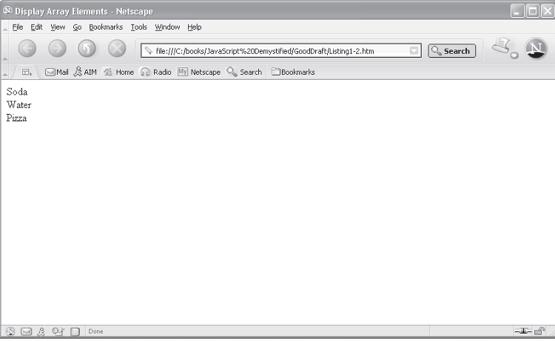
Sample Program:
<html >
<head>
<title>Display Array Elements</title>
</head>
<body>
<script language="Javascript" type="text/javascript">
var products = new Array() //Output
products[0] = 'Soda '
products[1] = 'Water'
products[2] = 'Pizza'
for (var i = 0; i < products.length; i++)
document.write(products[i] + '<br>')
</script>
</body>
</html>

Slide 7
Array Methods:
1) sort():
The sort() method reorders values assigned to elements of the array,
regardless of the index of the element to which the value is assigned.
Here’s what you need to do to sort an array:
1. Declare the array.
2. Assign values to elements of the array.
3. Call the sort() method.
Syntax: sort()

Slide 8
Array Method Example:
//sort()
<script>
var arr=[2,4,1,8,5]
var result=arr.sort().reverse(); // 8,5,4,2,1
document.writeln(arr[0]);
</script>

Slide 9
Array Methods:
2) slice():
The slice() method copies a sequential number of array elements from one array into a new array.
This means values of these elements exist in both arrays.
The slice() method has two arguments, which tell the slice() method which elements should be copied into the new array.
The first element tells the method where to start copying, and the second element tells the method where to end.
The second argument is the element immediately after the last element to copy i.e. it will always consider the value end-1.
Syntax: slice(start, end)

Slide 10
slice() Example:
<script>
var fruits = ["Banana", "Orange", "Lemon", "Apple", "Mango"];
var citrus = fruits.slice(1, 3);
for( var i=0;i<citrus.length;i++)
{
document.write(citrus[i]+ “<br>”);
}
</script>
Output:
Orange
Lemon

Slide 11
Array Methods:
3) concat() and join():
Array elements can be combined in two ways: by using the concat() method or the join() method of the array object.
Both of these methods do practically the same thing i.e., they concatenate copies of values of array elements.
Values of these elements remain untouched in the array.(It doesn’t change array)
The concat() method separates each value with a comma.
The join() method also uses a comma to separate values, but you can specify a character other than a comma to separate values.
Syntax: concat()
join(separator) //separator optional

Slide 12
slice() Example:
<script>
var fruits = ["Banana", "Orange", "Lemon", "Apple", "Mango"];
var citrus = fruits.concat();
var citr =fruits.join(‘ ‘);
document.write(citrus);
document.write(citr);
</script>
Output concat():
Banana,Orange,Apple,Mango
Output join():
Banana Orange Apple Mango

Slide 13
Array Methods:
5) shift():
The shift() method removes and returns the first element of the array and then moves the other tasks up on the list.
Syntax: shift()
Example:
<script>
var arr=["AngularJS","Node.js","JQuery"];
var result=arr.shift();
for(int i=0;i<arr.length;i++)
{
document.writeln(arr[i]);
}
</script>
Output: Node.js JQuery

Slide 14
Array Methods:
6) push():
The push() method creates a new element at the end of the array and assigns the value that you place between the parentheses of the new element.
Syntax: push(item1, item2, …. , item n)
Example:
<script>
var arr=["Node.js","JQuery"];
var result=arr.push("AngularJS");
for(int i=0;i<arr.length;i++)
{
document.writeln(arr[i]);
}
</script>
Output: Node.js JQuery AngularJS

Slide 15
7) pop():
The pop() method returns and removes the last element of the
array.
Syntax: pop()
Example:
<script>
var arr=[“Apple",”Banana“, “Kiwi”, “Grapes”];
var result=arr.pop();
for(int i=0;i<arr.length;i++)
{
document.writeln(arr[i]);
}
</script>
Output: Apple Banana Kiwi

Slide 16
8) reverse():
The reverse() method is used to reverse the contents of the array.
Syntax: reverse()
Example:
<script>
var arr=[“Apple",”Banana“, “Kiwi”, “Grapes”];
arr.reverse();
for(int i=0;i<arr.length;i++)
{
document.writeln(arr[i]);
}
</script>
Output: Grapes Kiwi Banana Apple

Slide 17
Array Class Methods:
Sr. No. | Methods | Description
1. | concat() | It returns a new array object that contains two or more merged arrays. array.concat(arr1,arr2,....,arrn)
2. | copyWithin() | It copies the part of the given array with its own elements and returns the modified array. array.copyWithin(target, start, end) target - The position where the copied element takes place. start - It is optional. It represents the index from where the method starts copying elements. By default, it is 0. end - It is optional. It represents the index at which elements stops copying. By default, it is array.length-1.
3. | fill() | It fills elements into an array with static values. arr.fill(value[, start[, end]]) value - The static value to be filled. start - It is optional. It represents the index from where the value starts filling. By default, it is 0. end - It is optional. It represents the index where the value stops filling. By default, it is length-1.

Slide 18
Array Class Methods:
Sr. No. | Methods | Description
4. | includes() | It checks whether the given array contains the specified element. array.includes(element,start) element - The value to be searched. start - It is optional. It represents the index from where the method starts search
5. | indexof() | It searches the specified element in the given array and returns the index of the first match. array.indexOf(element,index) element - It represent the element to be searched. index - It represent the index position from where search starts. It is optional.
6. | join() | It joins the elements of an array as a string. array.join(separator) Separator() - It is optional. It represent the separator used between array elements.
7. | lastindexof() | It searches the specified element in the given array and returns the index of the last match array.lastIndexOf(element,index) element - It represent the element to be searched. index - It represent the index position from where search starts. It is optional.

Slide 19
Array Class Methods:
Sr. No. | Methods | Description
8. | push() | It adds one or more elements to the end of an array array.push(element1,element2....element n)
9. | pop() | It removes and returns the last element of an array array.pop()
10. | reverse() | It reverses the elements of given array. array.reverse()
11. | sort() | It returns the element of the given array in a sorted order. By default, sort() method follows the ascending order. array.sort(compareFunction) compareFunction - It is optional. It represents a function that provides an alternative sort order.
12. | shift() | The shift() method removes the first element of the given array and returns that element. This method changes the length of the original array. array. shift()

Slide 20
Objects as Associative Array:
Associative array is a specialized array in which elements are stored in (Key, value) pair.
The associative array is created as:
var a= {“one” : 1, “two” : 2, “three” : 3};
<script type=“text/javascript”>
a=new Object();
a[“one”]=1;
a[“two”]=2;
a[“three”]=3;
a[“four”]=4;
for (i in a)
document.write(i+”=“ +a[i]+”<br>”);
</script>

